Slide 1
Carbohydrates, Proteins, fats, vitamins, minerals, and Water
Health- Unit 3 Nutrition

Slide 2
Carbohydrates
Carbohydrates, the starches and sugars found in foods, provide much of the fuel that keeps the body going, in much the same way that gasoline provides fuel to keep a car going.
CARBOHYDRATES are the body's most preferred source of energy. They make up, by far, the largest volume (60%) of our daily food.
Regulate Blood Sugar
Support digestion

Slide 3
Simple Carbohyrdrates
SIMPLE CARBOHYDRATES Simple carbohydrates are quick energy sources, but they do not usually supply any other nutrients or fiber.
SUGARS - Occurs naturally in some fruits and vegetables and is also produced in the body by breaking down other foods into glucose.
SOURCES
Monosaccharides contain only one molecule
Glucose, fructose, galactose
Fructose: known as fruit sugar. Most plants contain fructose, especially fruits and saps.
Glucose: found in fruits and vegetables, glucose is the energy for all types of living things including plants
Disaccharides contain two molecules
Lactose, maltose, sucrose
Maltose: known as malt sugar. Found in grains.
Lactose: commonly known as milk sugar. It is the principal carbohydrate found in milk.
Sucrose: commonly known as table sugar occurs in many fruits and some vegetables.

Slide 4
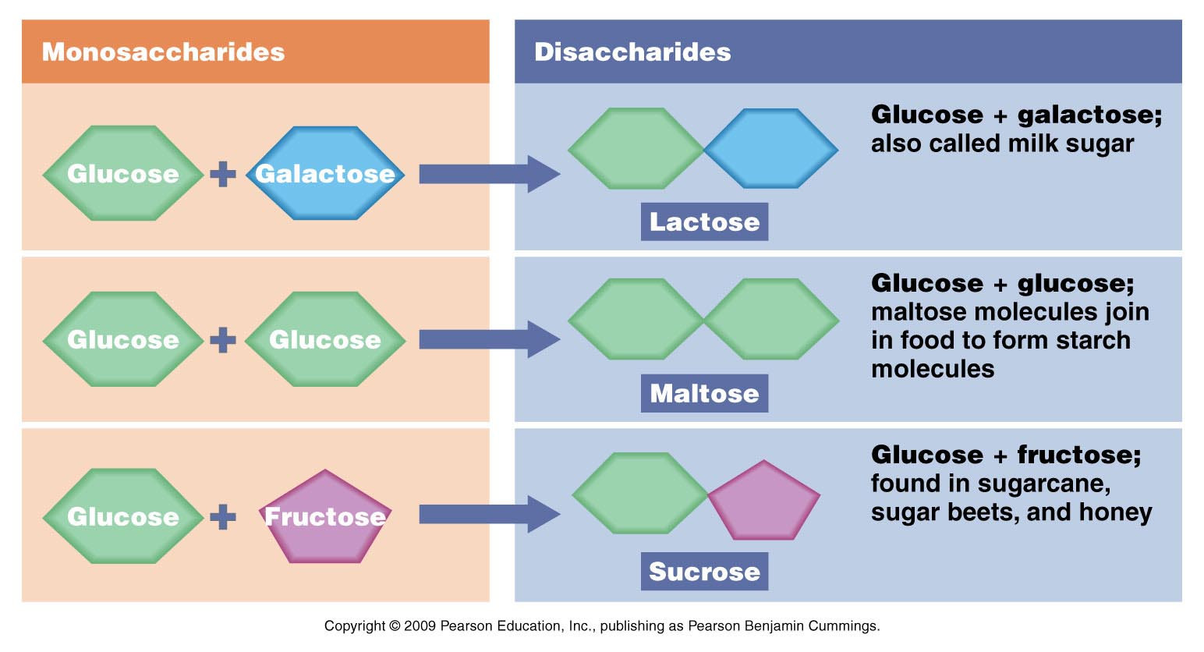

Slide 5
Complex Carbohyrdrates
COMPLEX CARBOHYDRATES Complex carbohydrates supply energy and other nutrients and fiber that the body needs. They are a better choice than simple carbohydrates.
Long chains of glucose molecules
Hundreds to thousands of molecules long
Also called polysaccharides
65-70% of your carbohydrates should be complex
STARCH - The body has to break down all sugar/starch into glucose to use it. Starch supplies the body with long, sustained energy.
They are made of many sugars linked together which takes the body longer to breakdown into glucose providing energy for a longer time.
SOURCES
Rice and grain are great sources of complex carbohydrates
Another important source of starch is the bean and pea family.
These include dry beans found at your local supermarket such as lima beans, pinto beans, kidney beans, black-eyed peas, chickpeas (garbanzo beans), and soybeans.
The third major source of starch is the tubers, such as the potato, yam, and cassava.

Slide 6
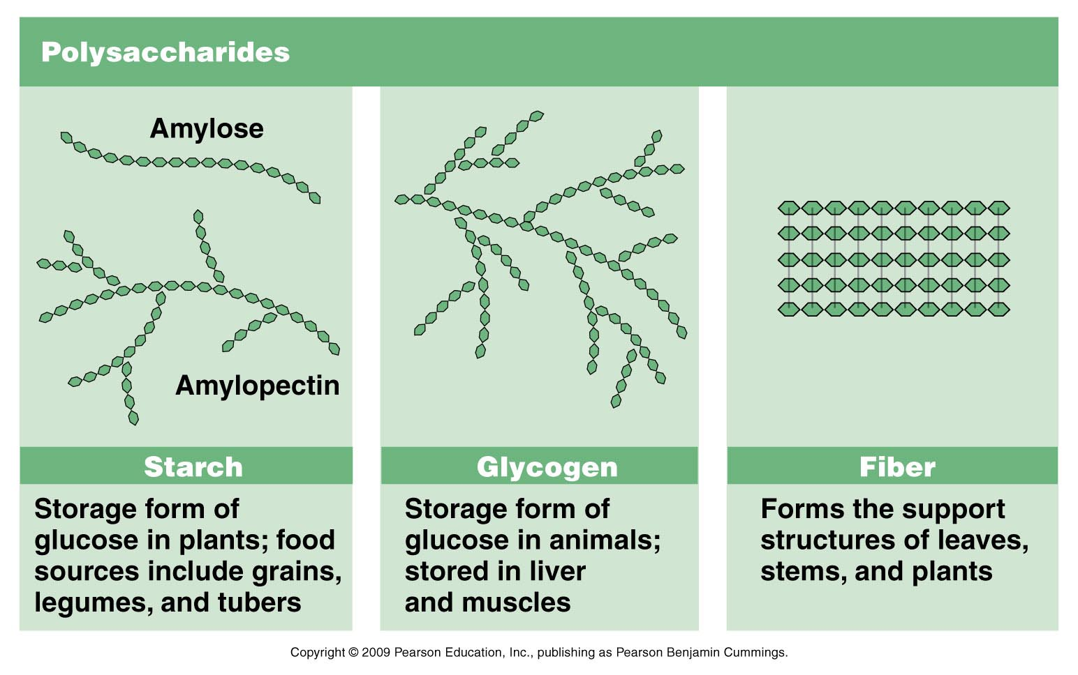

Slide 7
fiber
DIETARY FIBER - which is found in plant cells. Because it is tough and stringy, it does not break down completely in the body.
Fiber is essential for digestion in the body.
Cannot be digested and used as energy
Eating fiber daily has been shown to reduce some cancers and heart disease along with controlling diabetes
May help lower cholesterol and blood sugar
25 grams of fiber daily
FUNCTIONAL FIBER
carbohydrate extracted from plants and added to food that have known health benefits
SOURCES
Fiber - bran, whole-grain foods, raw vegetables and fruit (especially the seeds and skins), legumes, nuts, seeds and popcorn

Slide 8
Carbohydrates Cont.
SOME OF THE IMPORTANT SOURCES OF CARBOHYDRATES ARE:
SIMPLE CARBOHYDRATE:
Sugar - fruit, fruit juice, table sugar, honey, soft drinks, and other sweets
COMPLEX CARBOHYDRATE:
Starch - bread, cereal, potatoes, pasta, rice, and legumes (dried peas and beans)
Fiber - bran, whole-grain foods, raw vegetables and fruit (especially the seeds and skins), legumes, nuts, seeds and popcorn

Slide 9
Complex vs. Simple
Which one represents simple carbohydrates in relation to energy?
Which one represents complex carbohydrates in relation to energy?
Energy from simple carbohydrates
Energy from complex carbohydrates

Slide 10
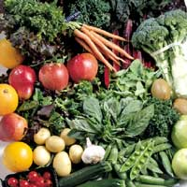
Role of Carbohydrates
Main source of energy
Glucose that is not used right away is stored in the liver as glycogen
If you consume more than you need and can not store it as glycogen, carbs are converted into fat
Converts carbohydrates to glucose
During intense exercise carbohydrate will supply 2/3 or more of the total energy needed

Slide 11
Simple vs. Complex
Diets high in simple sugars
Can cause dental problems such as cavities and gum disease
Are associated with increased levels of “bad cholesterol”
Are associated with decreased levels of “good cholesterol”

Slide 12
proteins
Nutrients that help build and maintain body tissues
Muscles, bone, connective tissue, teeth, skin, blood, and vital organs all contain protein.
Proteins are made of chains of building blocks called amino acids
SOURCES
Your body can make all but 9 of the 20 different amino acids.
The nine your body can not make are called essential amino acids because they must come from foods you eat.
Complete proteins and incomplete proteins

Slide 13
Complete proteins
Foods that contain all the essential amino acids in the right amounts.
SOURCES
Fish, meat, poultry, eggs, milk, cheese, yogurt, soybean products

Slide 14
Incomplete proteins
Lacking some of the essential amino acids.
SOURCES
legumes, nuts, and whole grains
( Legumes are plants that have pods with tidy rows of seeds inside. This category includes beans, peas, and peanuts. )
Combining theses types of foods can produce complete proteins.
EX. Combining peanut butter on a slice of whole wheat bread provides all the essential amino acids.

Slide 15
Role of proteins
Growth, maintenance, and repair of body tissue
Need protein to make muscles, skin, hair, blood vessels
Cannot grow without protein
Replace lining of GI tract every 3 days (maintenance example)
Enzymes
Enzymes are proteins that catalyze (speed up) chemical reactions
Every reaction in the body requires a specific enzyme

Slide 16
Role of proteins
Hormones
Hormones are chemical messengers
Travel to target cells/organs and ilicit a response
Examples:
Insulin and glucagon
Growth hormone
Thyroxin – regulates metabolic rate
Antibodies
Component of immune system
Attack foreign substances in the body
Antibodies
Component of immune system
Attack foreign substances in the body

Slide 17
Fats
Type of lipid – a fatty substance that does not dissolve in water
Composed of carbon, hydrogen, and oxygen like carbs
Saturated and Unsaturated

Slide 18
Saturated fats
Saturated Fats
Holds all the hydrogen atoms it can
Solid at room temperature
SOURCES
Palm oil, kernel oil, coconut oil,
Animal fats
Beef, pork, egg yolks, and dairy foods are high in fat.
Chicken and fish contain some fat, but are lower than the above foods
Saturated fats and trans fats may increase cholesterol and are associated with an increased risk for heart disease.

Slide 19
Unsaturated fats
Fatty acid that is missing one or two pairs of hydrogen atoms
SOURCES
Vegetable oils
olive, canola, soybean, corn, and cottonseed oils
Hydrogenation can change the make up of unsaturated fat in vegetable oils to change firmness or texture
EX. Margarine is vegetable oil in hydrogenated form
Two types of unsaturated fats
Monounsaturated and polyunsaturated

Slide 20
Polyunsaturated, monounsaturated, and Trans Fat
Both polyunsaturated and monounsaturated fats may help lower your blood cholesterol level when you use them in place of saturated and trans fats.
SOURCES
salmon, trout, herring, avocados, olives, walnuts and liquid vegetable oils such as soybean, corn, safflower, canola, olive and sunflower.
Trans-fatty Acids Trans-fatty acids (TFA) are found in small amounts in various animal products such as beef, pork, lamb and the butterfat in butter and milk.
TFA are also formed during the process of hydrogenation, making margarine, shortening, cooking oils and the foods made from them a major source of TFA in the American diet. Partially hydrogenated vegetable oils provide about three-fourths of the TFA in the U.S. diet.
TFA or hydrogenated fats tend to raise total blood cholesterol levels. TFA tend to raise LDL (bad) cholesterol and lower HDL (good) cholesterol

Slide 21
Fats
Saturated Fats | Polyunsaturated Fats | Monounsaturated Fats
Butter | Corn oil | Canola oil
Lard | Fish oils | Almond oil
Meat, lunchmeat | Soybean oil | Walnut oil
Poultry, poultry skin | Safflower oil | Olive oil
Coconut products | Sesame oil | Peanut oil
Palm oil, palm kernel oil and products | Cottonseed oil | Avocado
Dairy foods (other than skim) | Sunflower oil | Olives
Partially hydrogenated oils | Nuts and seeds | Peanut butter

Slide 22
Reducing fat in our diets
1. Eat less meat - eat more fish and poultry
2. Forget frying - steam, boil, bake, microwave
3. Switch to reduced fat and non-fat dairy products – skim milk
4. Season with herbs and spices – avoid butter, margarine, fatty sauces
5 Avoid high fat fast foods – hot dogs, fried foods, pastries
6. Say no to ice cream – nonfat frozen yogurt instead
7. Read labels carefully – cholesterol free does not mean fat free
8. Check the numbers – no more than 3 fat grams per 100 calories
9. Remove all visible fat – choose lean cuts and trim the fat
10. Think small – a serving of meat is the palm of your hand or a deck of cards, eat larger amounts of vegetables

Slide 23
Vitamins
Organic substance which an organism must obtain from it’s environment in small amounts
Function: they act by promoting a specific chemical reaction
Classification
Fat soluble (A, D, E, K)
Water soluble (B group, C)

Slide 24
Vitamin A
Function
night vision is the best known function of vitamin A (formation of retinal pigment that helps the eye to see in dim light)
maintains epithelial cells such as skin, lung, and intestinal tissue.
normal development of teeth and bones.

Slide 25
Vitamin A
Sources: liver, egg yolk, fortified foods, green leafy vegetables, orange and red fruits and vegetables, carrot, peach, apricot, prune, kidney, butter, oily fish and milk.
Destroyed by cooking and exposure to light

Slide 26
VITAMIN D
Promotes absorption and use of calcium which is essential for normal bone and tooth development
Produced in the skin by exposure to ultraviolet light
milk properly fortified with vitamin D, fatty fish such as salmon and mackerel, cod liver oil, fish liver oil, some breads and cereals, and some egg yolks.

Slide 27
Vitamin E
The most widely accepted biological function of vitamin E is its antioxidant properties
Food sources: Vegetables and seed oils including soybean, and corn; sunflower seeds; nuts; whole grains;

Slide 28
Vitamin K
Essential for blood clotting and its regulation of blood calcium level
SOURCES
Cooked dark green vegetables, such as spinach, kale and broccoli

Slide 29
Vitamin B1
Thiamine
Function
converts glucose into energy or fat
Sources
Cereal, milk, egg, liver, peas, beans

Slide 30
B2
Riboflavin
Function:
Essential in producing energy from carbs and fats
Sources:
milk, cheese, spinach, eggs, beef liver

Slide 31
Niacin
Function
maintenance of all body tissue
Sources
whole grain cereal, milk, egg, liver, meat, veg.

Slide 32
B12
Function
Normal development of red blood cells
Sources
meat, fish, milk, and other dairy foods
Deficiency
Lack of intrinsic factors cause pernicious anemia

Slide 33
Folic acid
Folate
Function
Reduces risk of birth defects, aids in production of red blood cells
Sources
Green leafy vegetables, orange juice

Slide 34
Vit. C
Ascorbic acid
Function
Protects against infection, aids in formation of connective tissue, helps wounds heal
Sources
Citrus fruits, tomatoes, cabbage, broccoli, potatoes, peppers

Slide 35
Water
65-70% of body weight
It is the basis of all body fluids
Function
Needed for all chemical reactions
Maintain body temp. & lubrication
Person can live on it , die without it
Sources
Fluids
Food
Metabolic activity

Slide 36
Water
Balance: maintained by kidney, lost through urination, and sweating
Dehydration: loss of water usually happens during excessive vomiting, diarrhea, hemorrhage, and burns

