Slide 1
K2 (Spice), Salvia, Bath Salts Dangerous New Drugs
Mr. Hageman Health

Slide 2
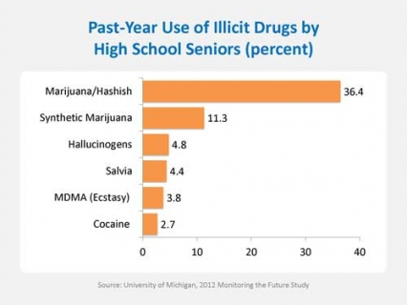
Drug Usage Statistics for Seniors

Slide 3
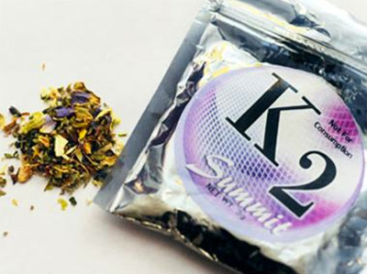
K2 – Spice – Synthetic Marijuana

Slide 4
K2 - Spice
Spice—also known as K2, Fake Marijuana, Skunk, and other names—is a synthetic (or man-made) substance made from shredded dried plant materials and chemicals.
Spice appears to stimulate the same brain receptors—molecules that recognize specific chemicals and transmit messages into cells—as marijuana does and produces a similar “high.

Slide 5
Spice cont.
Like marijuana, Spice is usually abused by smoking, but it can be prepared as a drink.
Spice is marketed as being “natural,” many people believe that is legal or regulated because it is sold in packaging and can be found in many stores across the United States.

Slide 6
Dangers of Spice
The ingredients used to make Spice can vary, and without any type of regulation, people producing Spice are using different methods and mixtures of ingredients—meaning the results could have dangerous effects on your body and brain. Some mixtures even contain harmful metal residues.

Slide 7
Spice cont.
Spice is illegal in the United States and in most European countries.
Spice products are labeled “not fit for human consumption” and are illegal in the United States and most European countries.
Its side effects, like the ingredients, often vary, but emergency rooms report seeing people with rapid heart rates, vomiting, agitation, and hallucinations.

Slide 8
Spice cont.
Chemicals used in Spice have a high potential for abuse and no medical benefit,
The Drug Enforcement Administration (DEA) has designated the five active chemicals most frequently found in Spice as Schedule I controlled substances, making it illegal to sell, buy, or possess them.

Slide 9
Statistics for Spice
Spice products are popular among young people
Illicit drugs most used by high-school seniors, Spcie is second only to marijuana. (They are more popular among boys than girls — in 2012, nearly twice as many male 12th graders reported past-year use of synthetic marijuana as females in the same age group.)
Easy access and the misperception that Spice products are “natural” and therefore harmless have likely contributed to their popularity.
Another selling point is that the chemicals used in Spice are not easily detected in standard drug tests.

Slide 10
Salvia
Salvia (Salvia divinorum) is an herb common to southern Mexico and Central and South America.
Salvinorin-A, the active property of salvia divinorum, is considered to be the most potent, selective and naturally occurring hallucinogen when smoked — rivaling the potency of the synthetic hallucinogens like LSD.
These receptors differ from those activated by the more commonly known opioids, such as heroin and morphine.

Slide 11
Salvia cont.
Traditionally, S. divinorum has been ingested by chewing fresh leaves or by drinking their extracted juices.
The dried leaves of S. divinorumcan can also be smoked as a joint, consumed in water pipes, or vaporized and inhaled.

Slide 12
Salvia cont.
People who abuse salvia generally experience hallucinations or “psychotomimetic” episodes (a transient experience that mimics a psychosis).
This drug is a psychoactive hallucinogen that can cause dramatic and sometimes frightening mind-states.
They include psychedelic-like changes in visual perception, mood and body sensations, emotional swings, and feelings of detachment

Slide 13
Salvia cont.
Although Salvia currently is not a drug regulated by the Controlled Substances Act, several States and countries have passed legislation to regulate its use.
However, three states have banned the leafy green, making its possession — like that of heroin or cocaine — a felony. The Drug Enforcement Agency has listed Salvia as a drug of concern and is considering classifying it as a Schedule I drug, like LSD or marijuana.

Slide 14
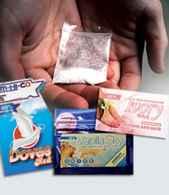
Bath Salts

Slide 15
Bath Salts
Bath Salts are sold under a number of different “brand” names, and as different products, such as plant feeder or insect repellent.
Brand names include: Bliss, Blue Silk, Cloud Nine, Drone, Energy-1, Ivory Wave, Lunar Wave, Meow Meow, Ocean Burst, Pure Ivory, Purple Wave, Red Dove, Snow Leopard, Stardust, Vanilla Sky, White Dove, White Knight, and White Lightning.

Slide 16
Bath Salts cont.
Bath Salts are substituted cathinones, which are synthetic, concentrated versions of the stimulant chemical in Khat.
Methylenedioxypyrovalerone (MDPV), mephedrone and methylone are the chemicals most often found in Bath Salts

Slide 17
Bath Salts cont.
Bath Salt products are sold in powder form in small plastic or foil packages of 200 and 500 milligrams under various brand names.
Mephedrone is a fine white, off-white or slightly yellow-colored powder. It can also be found in tablet and capsule form.
K2 is typically sold in small, silvery plastic bags of dried leaves and marketed as incense that can be smoked. It is said to resemble potpourri.

Slide 18
Bath Salts cont.
Bath Salts are usually ingested by sniffing/snorting. They can also be taken orally, smoked, or put into a solution and injected into veins.

Slide 19
Bath Salts cont.
Short-term effects include very severe paranoia that can sometimes cause users to harm themselves or others.
Effects reported to Poison Control Centers include suicidal thoughts, agitation, combative/violent behavior, confusion, hallucinations/psychosis, increased heart rate, hypertension, chest pain, death or serious injury.
The speed of onset is 15 minutes, while the length of the high from these drugs is 4-6 hours.

Slide 20
Bath Salts cont.
On October 21, 2011, DEA published a final order in the Federal Register exercising its emergency scheduling authority to control three of the synthetic stimulants that are used to make bath salts.
As a result of this order, these synthetic stimulants are designated as Schedule I substances under the Controlled Substances Act.

